Slide 1
TOURS AND TRAVELS WEB APPLICATION
No more monotonous
holiday
Team members:
K.Kavya(20CS1057),
B.Kiruthika(20CS1058).

Slide 2

Problem
Statement
Ideas for vacation planning
Planning to execute the tour with all amenities is tiring
Surfing internet for each and every need
Difficulty in managing details of users and bookings
Lack of information about events

Slide 3

OBJECTIVES
Independent travel planning
All amenities in single platform
Simple and easy process
Exploration platform with added entertainment
Manages details of users and admins, clear record of bookings and payment

Slide 4
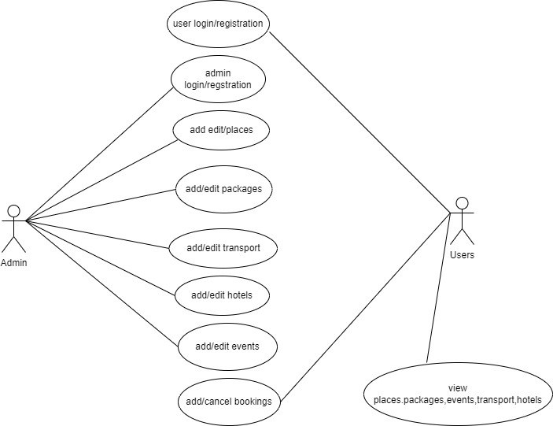
Use Case Diagram

Slide 5
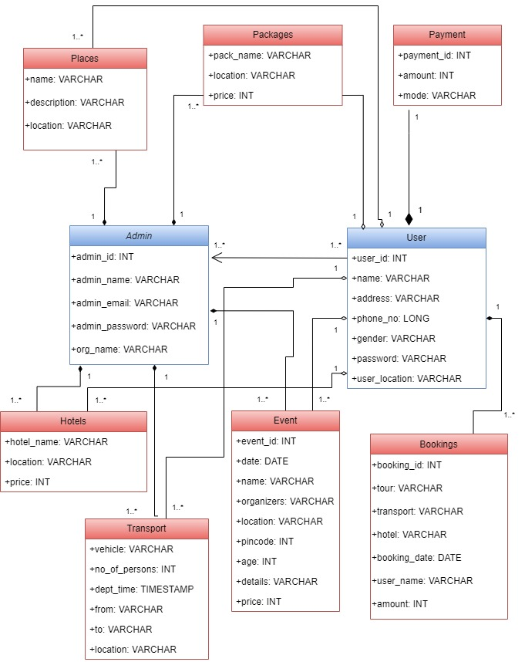
Class Diagram

Slide 6
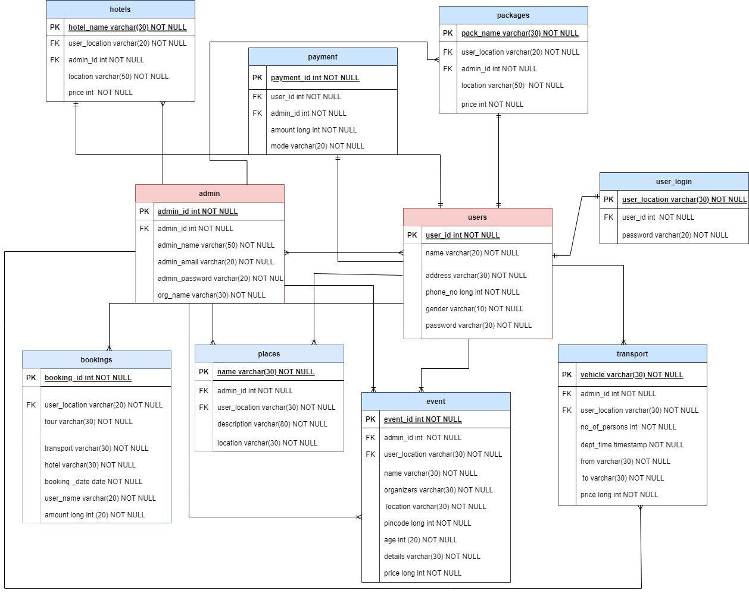
E-R Diagram

Slide 7
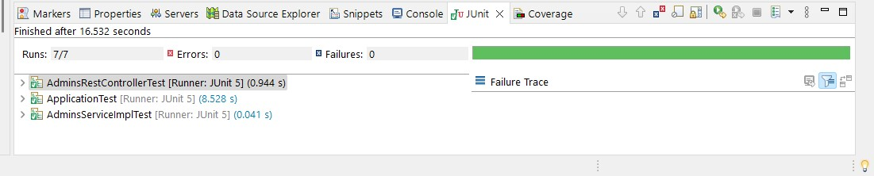
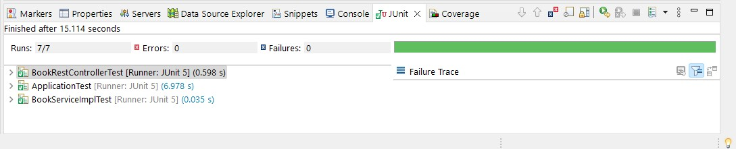
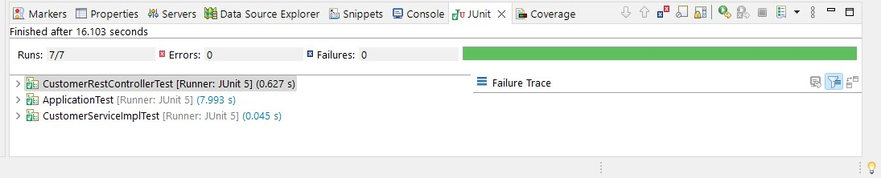
Test cases
Admin
Book
Customer

Slide 8

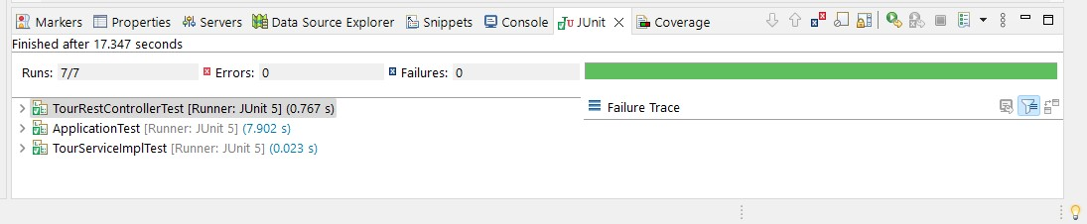
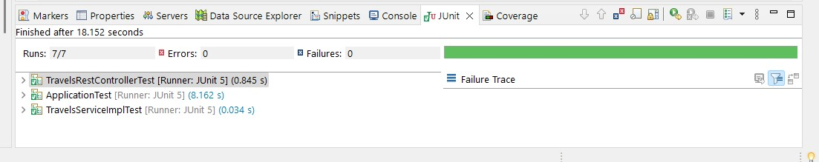
Test cases
Events
Tour
Travels

Slide 9
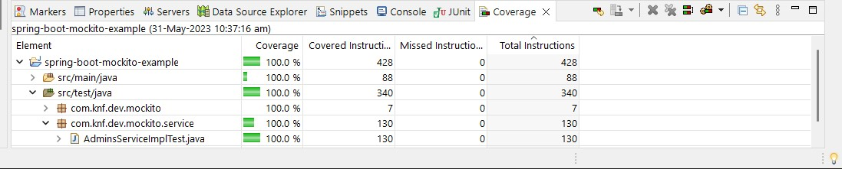
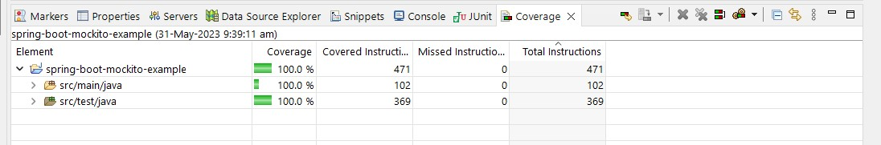
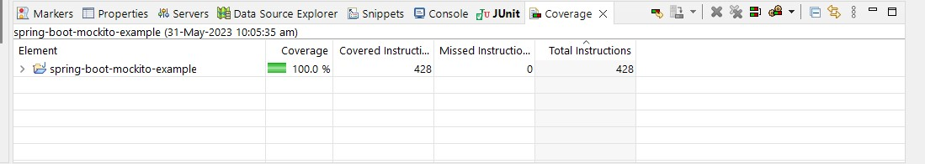
Code Coverage
Admin
Book
Customer

Slide 10
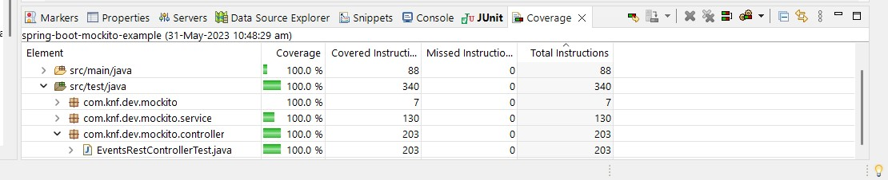
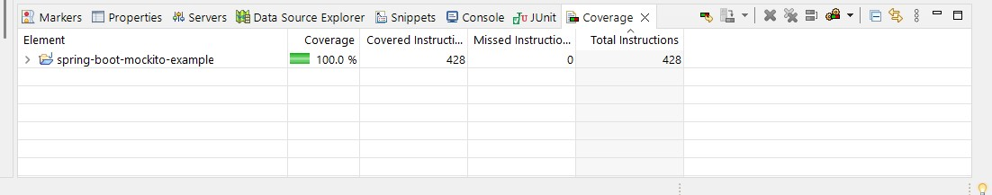
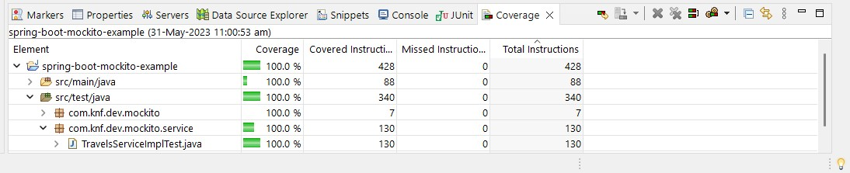
Code Coverage
Events
Tour
Travels

Slide 11
Conclusion
Our project domain is tours and travels website which provides the platform for the user to book the tickets with the overall packages to the different places around the world. The new features which we added is the user can book the events that are held in different places which is for entertaining the touristers along with the packages.And also the admin can login and view the bookings details and they can add or edit the events ,travels and packages. This website makes the tour booking process easier as it provides all the facilities in one paltform.

Slide 12
THANK YOU

